Slide 1

Introduction to statistics in R
Dal Grad Module Intro to R
Feb 2022
Chris Mull h/t Lindsay Davidson
https://lewesdepot.org/film/a-beautiful-mind

Slide 2
Introductory statistics lecture
Statistics: hypothesis testing, correlations, covariation, t-tests, p-values, ANOVAs
Data exploration: detect outliers, heterogeneity of variance, collinearity, dependence of observations.
Linear modelling: linear modelling, model validation, model summary
Notes:
Centering and scaling coefficients, Model selection (AIC) (time permitting)

Slide 3
Introductory statistics lecture
Statistics: hypothesis testing, correlations, covariation, t-tests, p-values, ANOVAs
Data exploration: detect outliers, heterogeneity of variance, collinearity, dependence of observations.
Linear modelling: linear modelling, model validation, model summary
Notes:
Centering and scaling coefficients, Model selection (AIC) (time permitting)

Slide 4
Hypothesis testing
Null Hypothesis (H₀) = no difference
Alternate Hypothesis (H₁) = difference
A test of differences:
H₀: “Species richness is the same between un-fished and fished areas”
H₁: “Species richness is different between un-fished and fished areas”
Hypothesis testing is carried out by examining the probability of the test statistic or summary if the null hypothesis were true.
Typically you reject the null hypothesis when p < 0.05. If p >0.05 then you “fail to reject the null hypothesis” you do not accept or prove the alternative hypothesis!
Notes:
Type 1 and Type II error –
Type 1 – reject the null hypothesis, false positive
Type II accept the null hypothesis, false negative

Slide 5
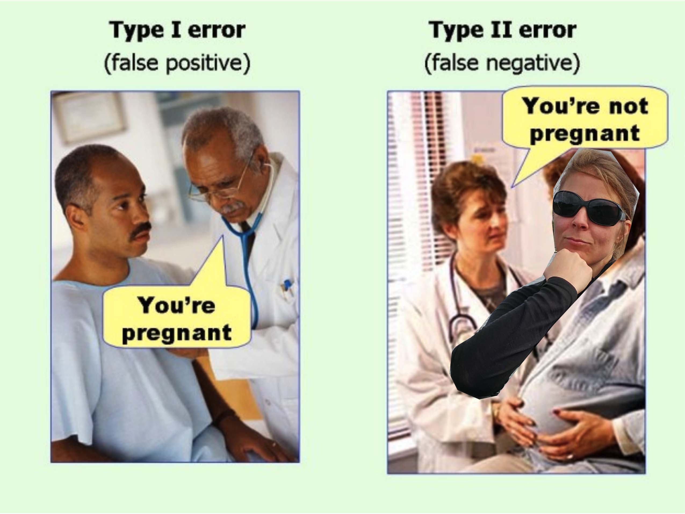
Error

Slide 6
P-value
Probability of the summary statistic if the null hypothesis were true.
P-values are from 0-1.0
Written as a decimal
P-value = 0.05 = 5% probability. This is the standard value but for some analyses people use 0.1, and it may be further modified for multiple comparisons.

Slide 7
What is a p-value and what is it not
Correct interpretation: P-values evaluate how well the sample data support the null hypothesis. What is the probability of obtaining an effect at least as extreme as the one in your sample data, assuming the truth of the null hypothesis.
Incorrect interpretation: P-value as the probability of making a mistake by rejecting a true null hypothesis
https://blog.minitab.com/blog/adventures-in-statistics-2/how-to-correctly-interpret-p-values

Slide 8
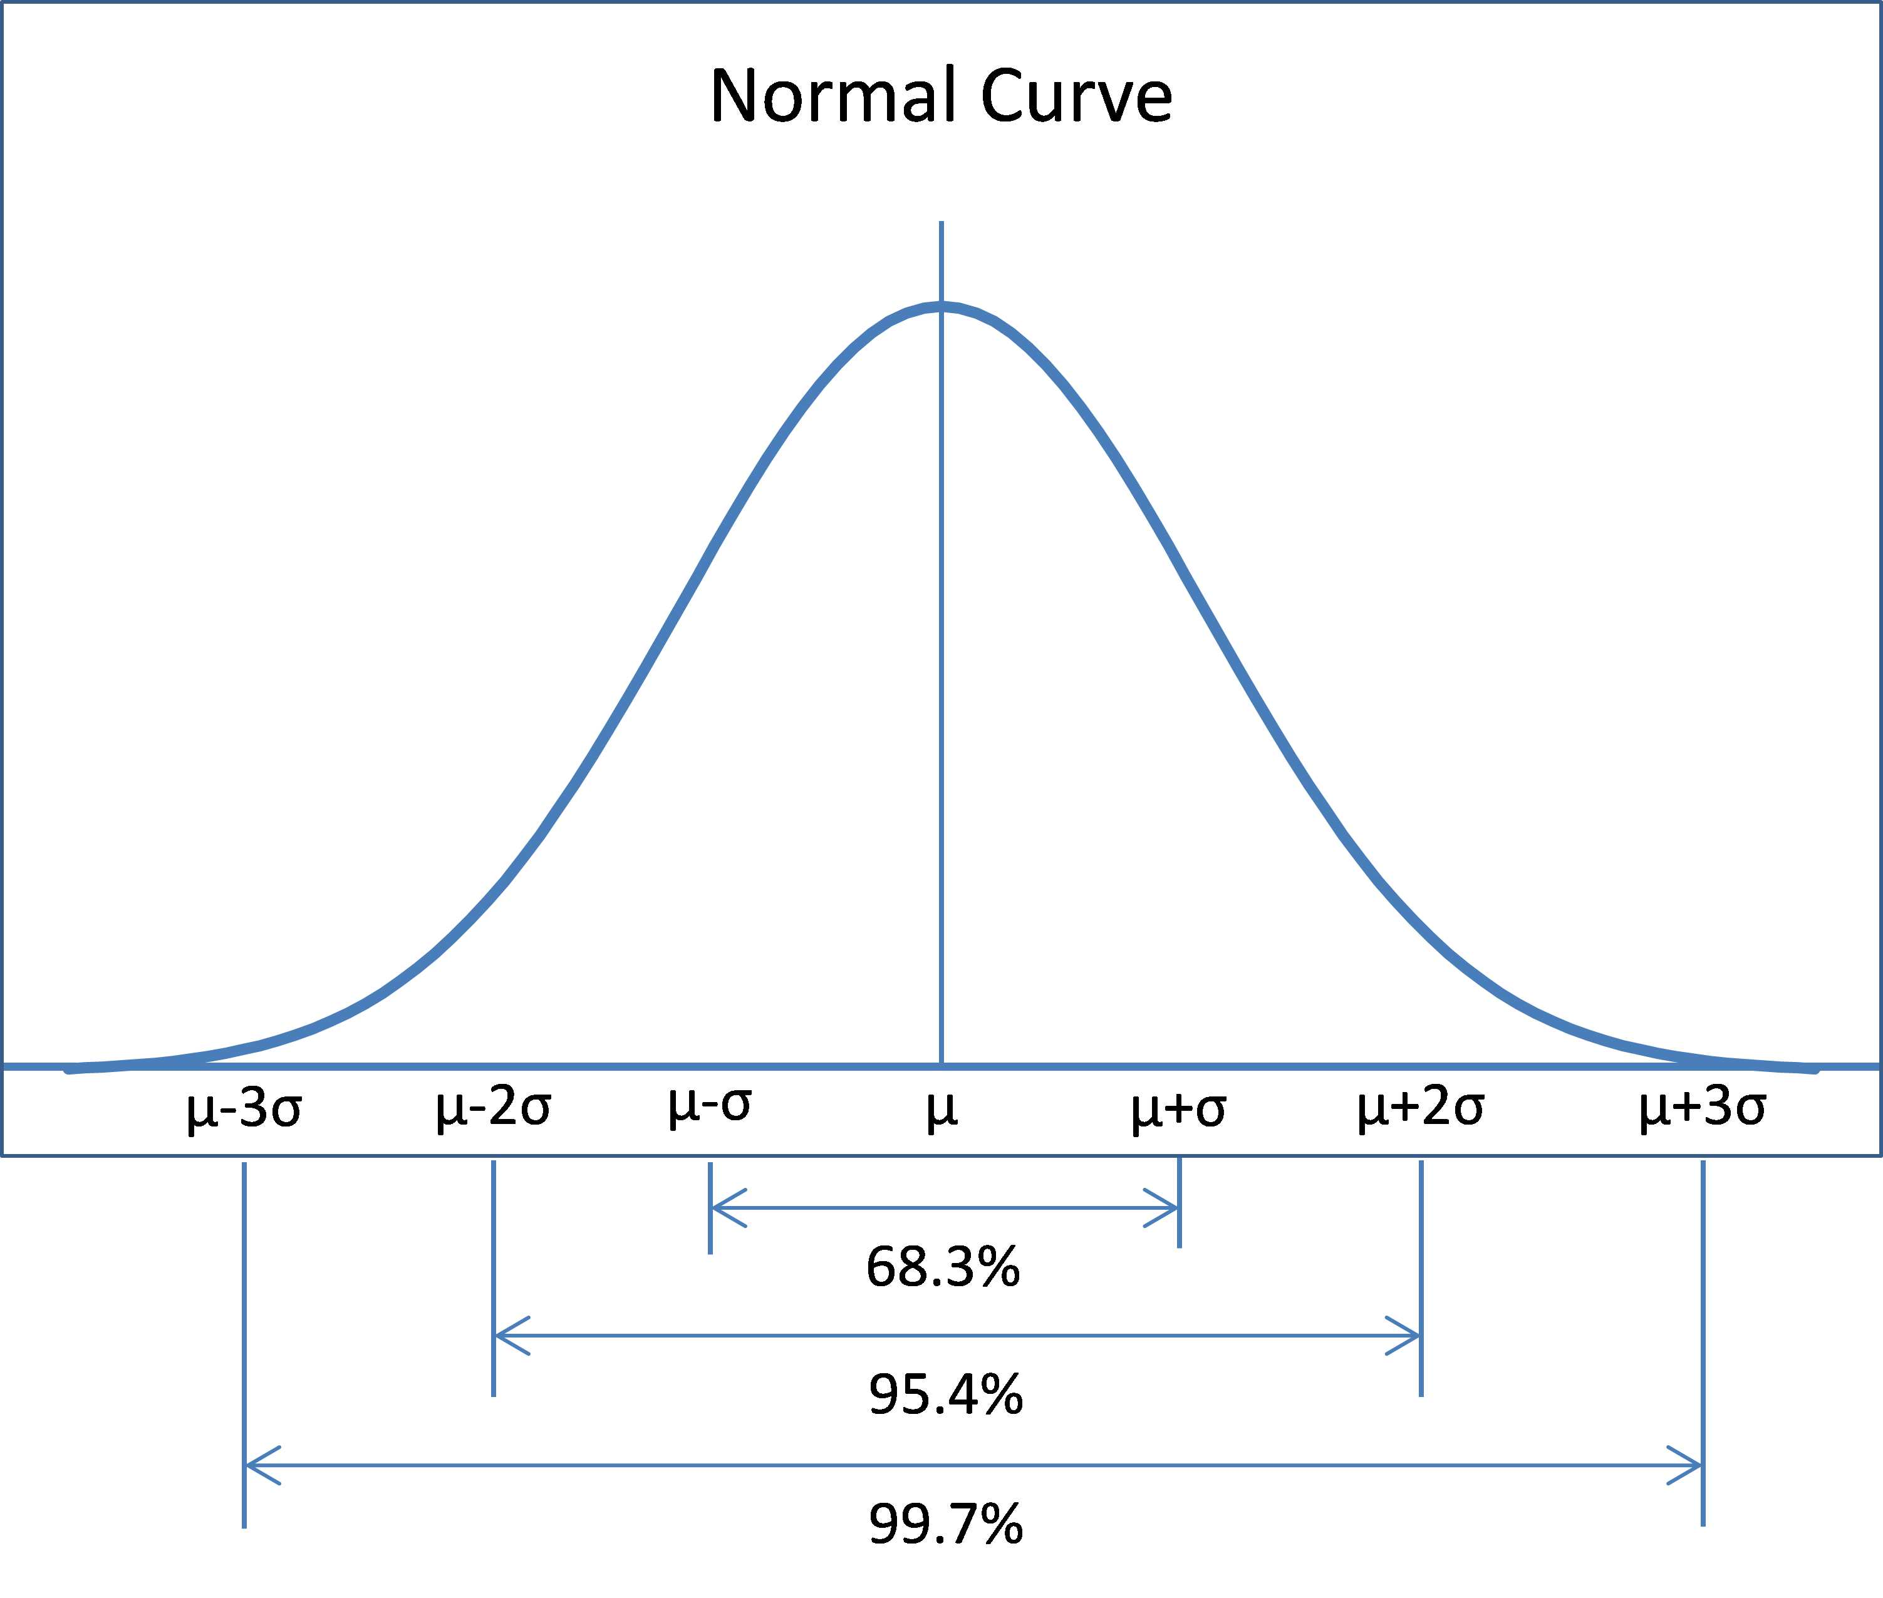
Does this data look weird to you?
One major assumption of statistical methods is that data is normally distributed
Can test for normality and choose the appropriate method

Slide 9
Correlation
When we wish to look for links between two samples which are continuous data then we are generally looking at correlations
When our data are normally distributed we use the Pearson’s. When our data are not normally distributed we use the Spearman’s rank test
Correlation does not necessarily mean causation!! It just means that two variables (or samples) are correlated
Notes:
Peastons
Spearmans rank

Slide 10

Notes:
Show a plot of a one to one relationship

Slide 11
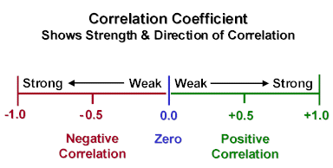
Correlation coefficient - r
Pearson’s test calculates a Pearson correlation coefficient – r
r values range between +1 and −1, where 1 is total positive correlation, 0 is no correlation, and −1 is total negative correlation

Slide 12
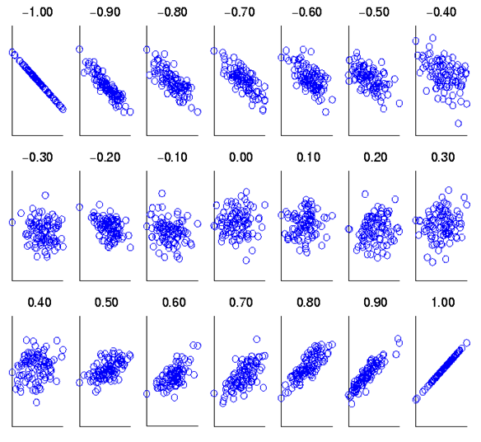

Slide 13


Correlation coefficient - r
The correlation coefficient also has an associated p-value (or probability of occurrence!) depending on the sample size
In R you can do a correlation test by:
cor.test(variable1, variable2, method=“pearson”)

Slide 14
T-test
Test of differences between 2 samples or 2 levels of a treatment (ie. fish/un-fished, logged/un-logged, above/below dam)
Examples:
Reproductive success between populations;
Predator abundance above and below a waterfall;
Mass of wrack deposition on small versus big island

Slide 15
T-test
H₀ = There is no difference in means between two samples (or treatments) (i.e. the samples are from the same distribution)
H₁ = There is a difference in means between two samples (or treatments) (i.e. the samples are from different distributions)

Slide 16
T-test: means are different
Logged
Un-Logged

Slide 17
T-test: means are similar

Slide 18
T-test
Student’s t-test – equal variances, normal distribution
Paired t-test – dependent t-test, each factor is measured twice, repeated measures, means significantly different from
Two sample t-test – samples are independent, samples from population. Default in R.
One-way sample t-test – sample mean is significantly different from a population mean
Welch’s – unequal variances

Slide 19
Performing a t-test in R
In R you can perform a t-test using:
t.test(response.variable~factor)
Notes:
Students ttest – equal variances, normal distribution,
Welch’s – unequal variances
Paired ttest – dependent ttest, each factor is measured twice, repeated measures
Two sample t-test – samples are independent, samples from population

Slide 20
ANalysis Of VAriance (ANOVA)
ANOVA is used when you want to test for differences between two or more groups. If you have just 2 factors = same as a t-test
When there are 3 or more levels you have to use analysis of variance (ANOVA)
E.g. 3 different measures of climate change and their affect on species performance

Slide 21
ANalysis Of VAriance (ANOVA)
Hypotheses:
H₀ = all population means are equal
H₁ = at least one of the population means are different
ANOVA compares common variance or within groups (S²_{within}) with variance between groups (S²_{between}) to produce a F-stat. Low F-stats (<1) indicate no difference between groups.

Slide 22
If you divide your data into groups, do they have distinct means?

Slide 23
Analysis of variance in R
In R we use the aov(Y~X) command, where Y is your continuous response variable and X is your factor.
An example ANOVA table showing the degrees of freedom (df), the Sum of Squares (SQ), Mean Square (M Sq), F statistic, and p-value associated with that F statistic

Slide 24
Analysis of variance in R
In R we use the aov(Y~X) command, where Y is your continuous response variable and X is your factor
They are significantly different – but which one of the three factors (species) is significantly different?

Slide 25
Tukeys HSD
Honest Significant Difference
Output shows the difference in means and show which pair of comparisons is significant
Performed in R using:
TukeysHSD(aov.object)
Notes:
Tukeys Honest Significant Difference
R code is TukeyHSD(aovoutput,
Padj gives you the output and shows you what is significant

Slide 26
Introductory statistics lecture
Statistics: hypothesis testing, correlations, covariation, t-tests, p-values, ANOVAs
Data exploration: detect outliers, heterogeneity of variance, collinearity, dependence of observations.
Linear modelling: linear modelling, model validation, model summary
Notes:
Centering and scaling coefficients, Model selection (AIC) (time permitting)

Slide 27
Data exploration
detect outliers
heterogeneity of variance
collinearity
dependence of observations
Zuur et al. 2010. A protocol for data exploration to avoid common statistical problems. MEE

Slide 28

Zuur et al 2010

Slide 29
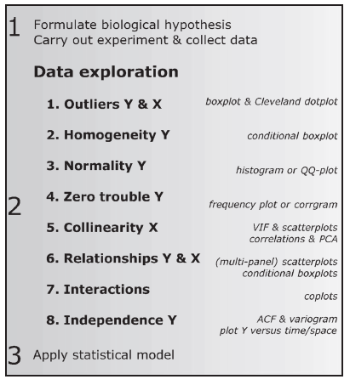
Zuur et al 2010

Slide 30
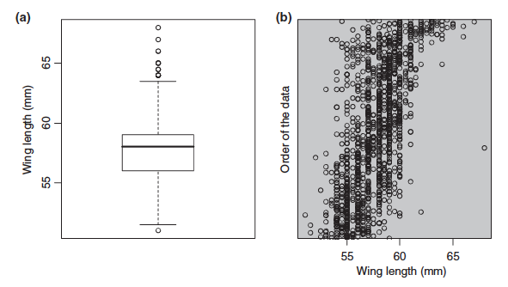
Detect outliers – Cleveland boxplots
Zuur et al. 2010. A protocol for data exploration to avoid common statistical problems. MEE

Slide 31
Detect outliers – Cleveland boxplots
Zuur et al. 2010. A protocol for data exploration to avoid common statistical problems. MEE

Slide 32
Heterogeneity of variance
Zuur et al. 2010. A protocol for data exploration to avoid common statistical problems. MEE
Notes:
In this case, there seems to be slightly less
variation in the winter data formales andmore variation in the
male data from the summer. However, such small differences
in variation are not something to worry about
As long as the biggest box is not much more than 2 times the smallest, the variance is ok.

Slide 33
Collinearity
When your independent variables are highly correlated.
What happens? Influences your outputs! They explain some of the same variance in the dependent variable, which in turn reduces their statistical significance.
What to do? Run a correlation and remove one of the pair of highly correlated variables. r > 0.7
VIF – variance inflation factor <3
Zuur et al. 2010. A protocol for data exploration to avoid common statistical problems. MEE

Slide 34
Collinearity
Zuur et al. 2010. A protocol for data exploration to avoid common statistical problems. MEE

Slide 35
Testing for independence
Many times you data may have an underlying correlation structure and observations are not truly independent.
Temporal and spatial autocorrelation – violates assumptions that observations are independent, as some sample will be closer to others in space or time.
Phylogenetic relatedness – some species are more closely related than others.
In these instances it is important to account for this in your analysis.

Slide 36
Introductory statistics lecture
Statistics: hypothesis testing, correlations, covariation, t-tests, p-values, ANOVAs
Data exploration: detect outliers, heterogeneity of variance, collinearity, dependence of observations.
Linear modelling: linear modelling, model validation, model summary
Notes:
Centering and scaling coefficients, Model selection (AIC) (time permitting)

Slide 37
The Linear Model
Regression is similar to correlation but here you test for causation
What is the slope (m) and intercept (b) i.e – what is the equation of your best fit line?
In R you can use the function lm (meaning linear model) to extract the coefficients for your slope and intercept
lm(variable1~variable2)
lm(Y~X)
Notes:
Basics of linear regression
10 samples per variable
Slope effects versus intercept effects
How to read a model output table
what do model coefficients mean in real terms
Model selection based on AIC

Slide 38
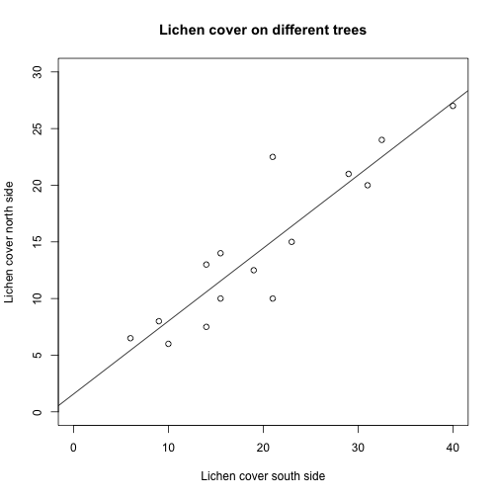
DEPENDENT VARIABLE
INDEPENDENT VARIABLE

Slide 39
DEPENDENT VARIABLE
INDEPENDENT VARIABLE

Slide 40
DEPENDENT VARIABLE
INDEPENDENT VARIABLE

Slide 41
Linear model:
y = mx + b
m = slope
b = intercept

Slide 42
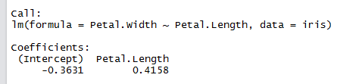
The Linear Model
The output in R looks like:
So your equation is: Y = -0.3631X + 0.418

Slide 43
The linear model in R
You can also extract the coefficients (your estimates for the slope and intercept), their standard errors, their corresponding p-values, and the r² of the model using the summary command. The p-value is the same as the Pearson test! The r² value is the r value squared!
lm<-lm(Y~X)
summary(lm)
Now you can easily plot the best fit line on your scatterplot using the abline command:
plot(Y~X)
abline(lm)

Slide 44
lm() syntax
Other symbols that can be used in the formula include:
a:b for an interaction between a and b,
a*b which expands to a + b + a:b,
. for first order terms of all variables in data
to exclude a term or terms,
1 to include an intercept (included by default)
0 to exclude an intercept

Slide 45
Let’s paractice!

Slide 46
Model diagnostics
R gives you four model outputs:
Residual versus fitted values
QQplot
Scale-Location
Residuals versus Leverage
https://support.minitab.com/en-us/minitab-express/1/help-and-how-to/modeling-statistics/regression/how-to/binary-logistic-regression/interpret-the-results/all-statistics-and-graphs/residual-plots/
Notes:
Reference

Slide 47
Model Residuals
All models have errors...that is the difference between our observed and predicted values.
Y = aX + b + ε
Diagnostics are run on the residuals of the model we have fit to our data.

Slide 48
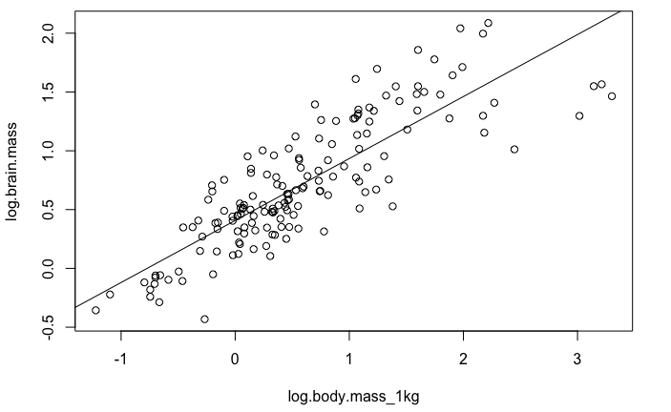
Model Residuals

Slide 49
Model diagnostics
R gives you four model outputs:
Residual versus fitted values: linearity
Qqplot: normality assumption
Scale-Location: influential points
Residuals versus Leverage
Notes:
Reference

Slide 50
Residual PLots
Checks for non-linearity on the residuals of your model
Plots residuals over fitted values
Should see equally spread residuals around a horizontal line with no apparent pattern

Slide 51
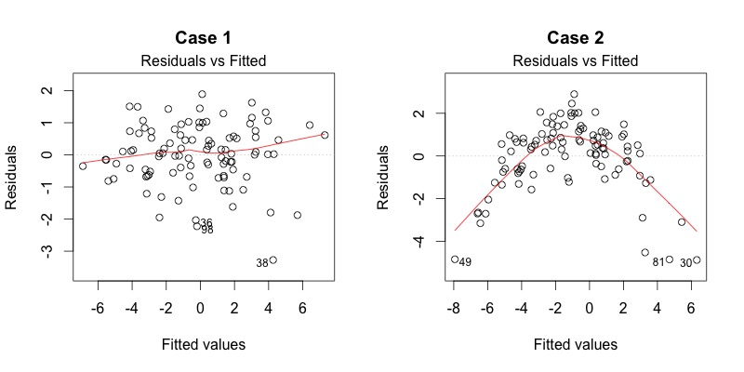
Residuals plots – good? Bad?
https://data.library.virginia.edu/diagnostic-plots/

Slide 52
Model diagnostics
R gives you four model outputs:
Residual versus fitted values
Qqplot: normality assumption
Scale-Location
Residuals versus Leverage
Notes:
Reference

Slide 53
QQplot
Plots empirical quantiles of a variable, or of studentized residuals from a linear model, against theoretical quantiles of a comparison distribution
Should see a clear straight line of residual values over theoretical quantiles
The “Fat Pen Test”

Slide 54
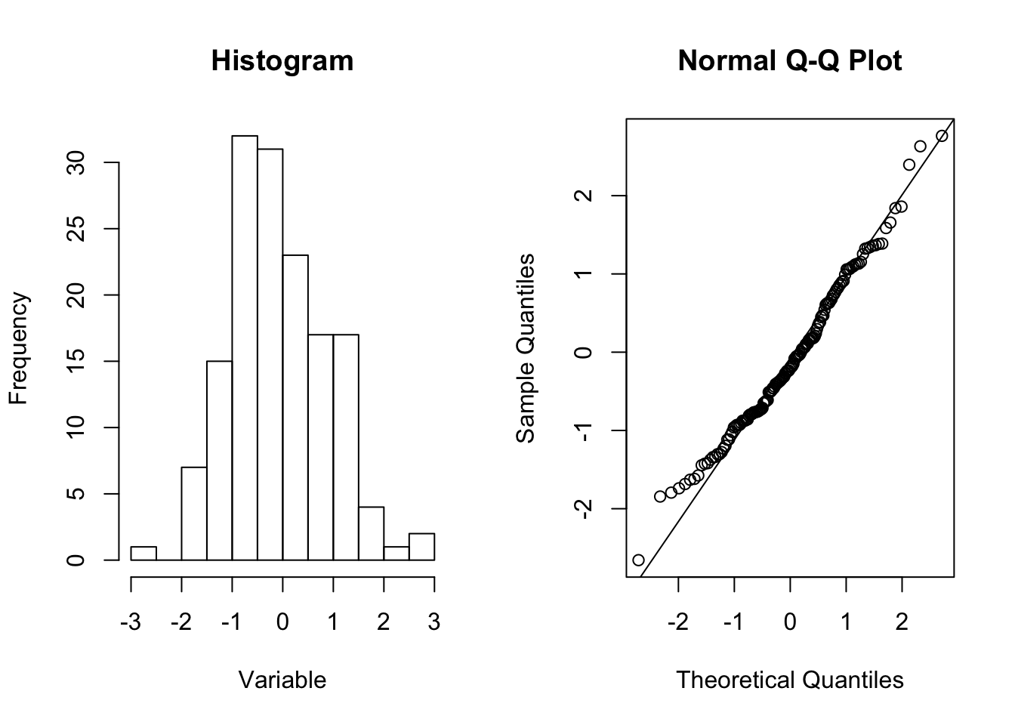
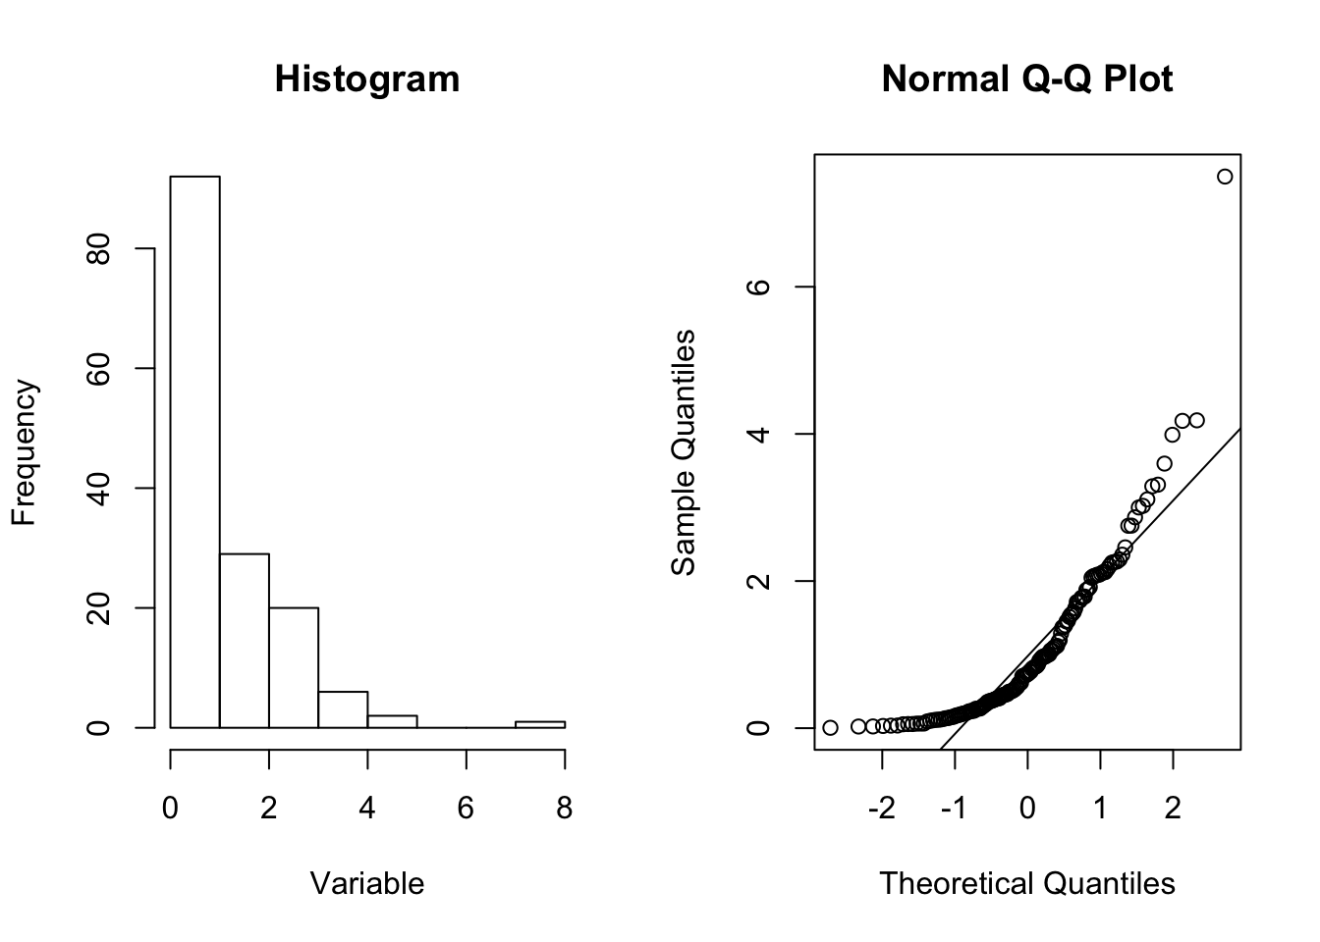
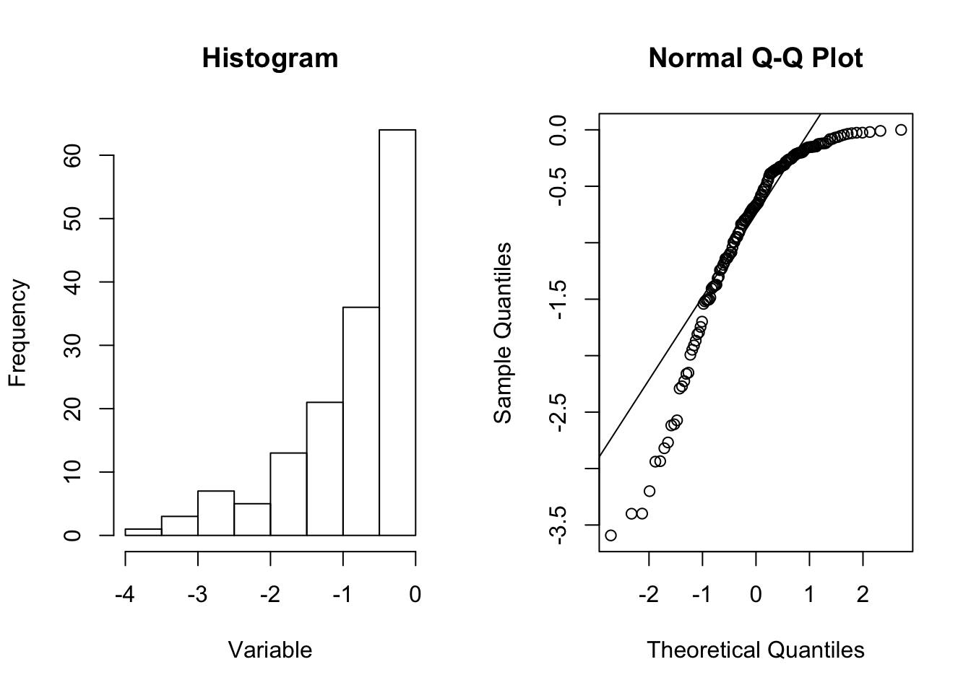
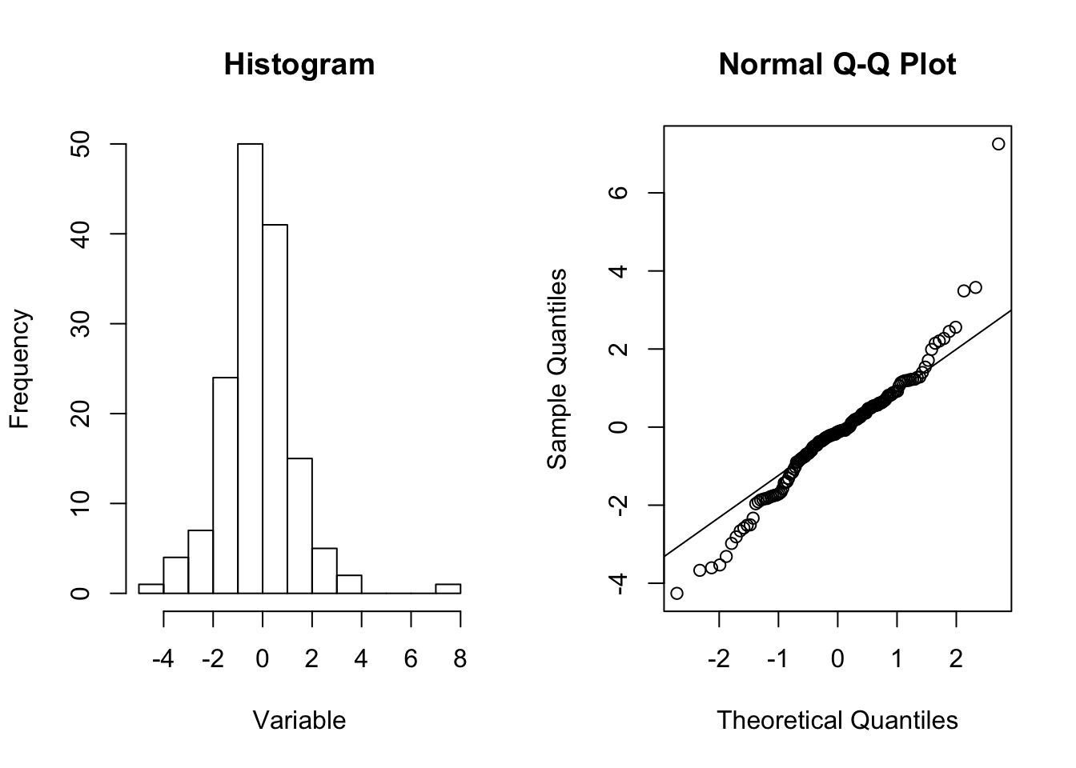
QQplot
(a) Normal distribution
(b) Left skew
(c) Right skew
(d) overdispersed
http://www.ucd.ie/ecomodel/Resources/QQplots_WebVersion.html

Slide 55
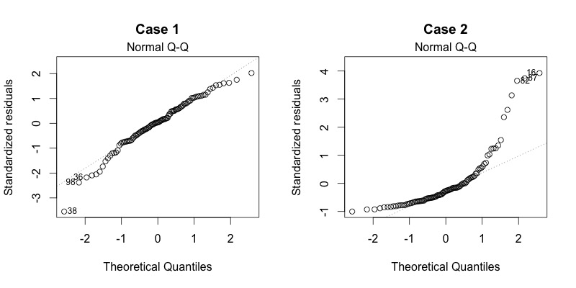
Qqplot - – good? Bad?
https://data.library.virginia.edu/files/diagnostics2.jpeg

Slide 56
Model diagnostics
R gives you four model outputs:
Residual versus fitted values
Qqplot
Scale-Location: equal residual variance - homescdasticity
Residuals versus Leverage
Notes:
Reference

Slide 57
Spread-Location plot
Checking to see that residuals are spread equally along the ranges of predictors. This is how you can check the assumption of equal variance (homoscedasticity). It’s good if you see a horizontal line with equally (randomly) spread points

Slide 58
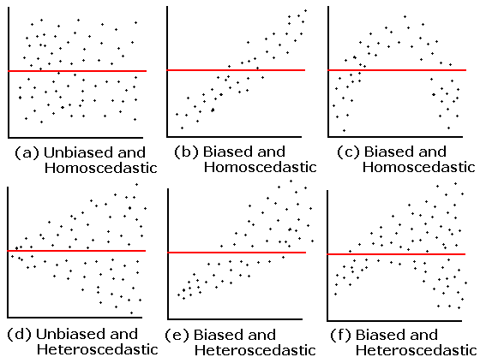
Spread-Location Plots
https://statsmethods.files.wordpress.com/2013/05/resid-plots.gif

Slide 59
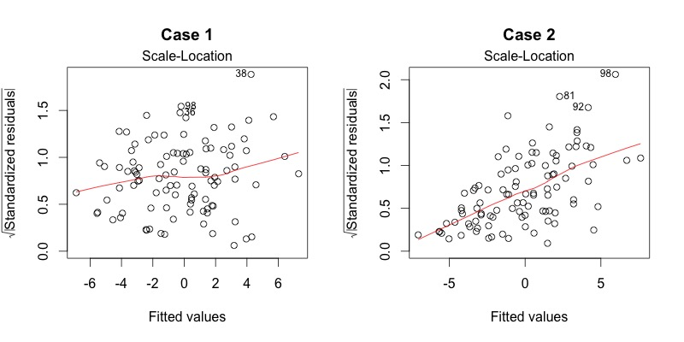
Spread-Location plot
https://data.library.virginia.edu/files/diagnostics3.jpeg

Slide 60
Model diagnostics
R gives you four model outputs:
Residual versus fitted values
Qqplot
Scale-Location
Residuals versus Leverage: Influential points
Notes:
Reference

Slide 61
Leverage
Cook’s distance is used to find influential outliers in a set of predictor variables.
The measurement is a combination of each observation’s leverage and residual values; the higher the leverage and residuals, the higher the Cook’s distance.
https://www.statisticshowto.datasciencecentral.com/cooks-distance/

Slide 62
Leverage
A general rule of thumb is that observations with a Cook’s D of more than 3 times the mean, μ, is a possible outlier.
a D_{i} value > 1 indicates an influential value, but look at values above 0.5.
https://www.statisticshowto.datasciencecentral.com/cooks-distance/

Slide 63
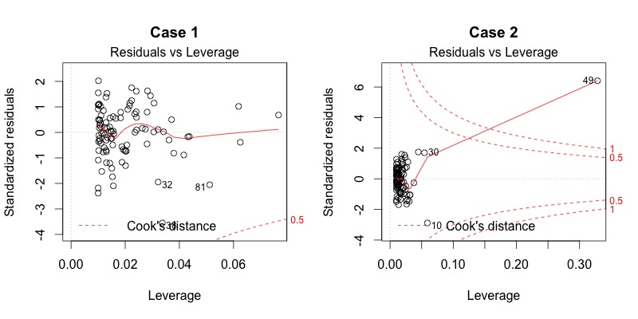
Leverage – good? Bad?
https://stats.stackexchange.com/questions/266597/plotting-cooks-distance-lines

Slide 64
Let’s check out our models!

Slide 65
Comparing Model Support
If we fit several models then how do we determine which is best?
R² gives a measure of goodness of fit, but is strongly influenced by how many predictor variables we include, so we may decide to pick the most complex model

Slide 66
Akaike’s Information Criteria
Based on an information theoretic approach, AIC is a way to measure relative quality or level of support for a given statistical model
Trade-off between goodness of fit and simplicity
AIC = 2k – 2 ln(L)
k is the number of parameters and L is the log likelihood of the model
Rule of thumb is that the lower the AIC score the better, and a ΔAIC of -2 signifies a model with the most support in the candidate set

Slide 67
Akaike’s Information Criteria
In r there are many packages that implement AIC model selection criteria {base, MuMIn, AICmodavg}
base::AIC(model1, model2, model3, model4)
Will return an object with model names, df, and AIC score. Can compare the relative support.

Slide 68
What AIC is not!
Always remember that AIC will tell you what model is the “most supported” of you set of candidate models...it will not tell you which model is “right”!
It is important to identify you set of candidate models or at least your candidate predictors and then perform analyses and model selection.

Slide 69
Let’s paractice!

